Slide 1
TEXT EDITOR GUI
-PYTHON FUNDAMENTALS
ASHISH KUMAR SINGH
SG15313
CSE(7th SEM)

Slide 2
Python and its Main Features
Simple and easy to learn
Free and open source.
General Purpose and high level programming language.
Platform independent.
Case Sensitive.
Interpreted Language.
Dynamically typed.
Rich Library.
We can write concise code using python.

Slide 3
Introduction
Text editor is an application like notepad to write documents and other files . The text editor is made using python using Tkinter GUI interface.

Slide 4
Objectives:
Tkinter interface for Text editor
Basic text editor tasks like cursor,line number
File handling to manage the text files
Different icons for cut,copy,info,find_text,new file,open file
Line numbers and column number display at the bottom.

Slide 5
Components of Text editor GUI
The application is built using python library Tkinter.
Tkinter is the standard GUI library for Python. Python when combined with Tkinter provides a fast and easy way to create GUI applications. Tkinter provides a powerful object-oriented interface to the Tk GUI toolkit.

Slide 6
Steps to start making editor
Import the Tkinter module.
Create the GUI application main window.
Add one or more of the above-mentioned widgets to the GUI application.
Enter the main event loop to take action against each event triggered by the user.

Slide 7
Steps to start making editor
File handling
To open and save files , the project is using Python file handling system and its basic method . The text editor offers functionalities like open , close ,edit and create new files using Python.

Slide 8
Steps to start making editor
GUI
The user interface is developed using tkinter components.
Grid
Toplevel
Messagebox
Mainloop

Slide 9
To create a text editor GUI: (Workflow)
Import module (Tkinter)
Create a new window
Add menu items
Adding functionality in menu items
Adding Icons and others functionality
Adding line numbers and scrolling

Slide 10
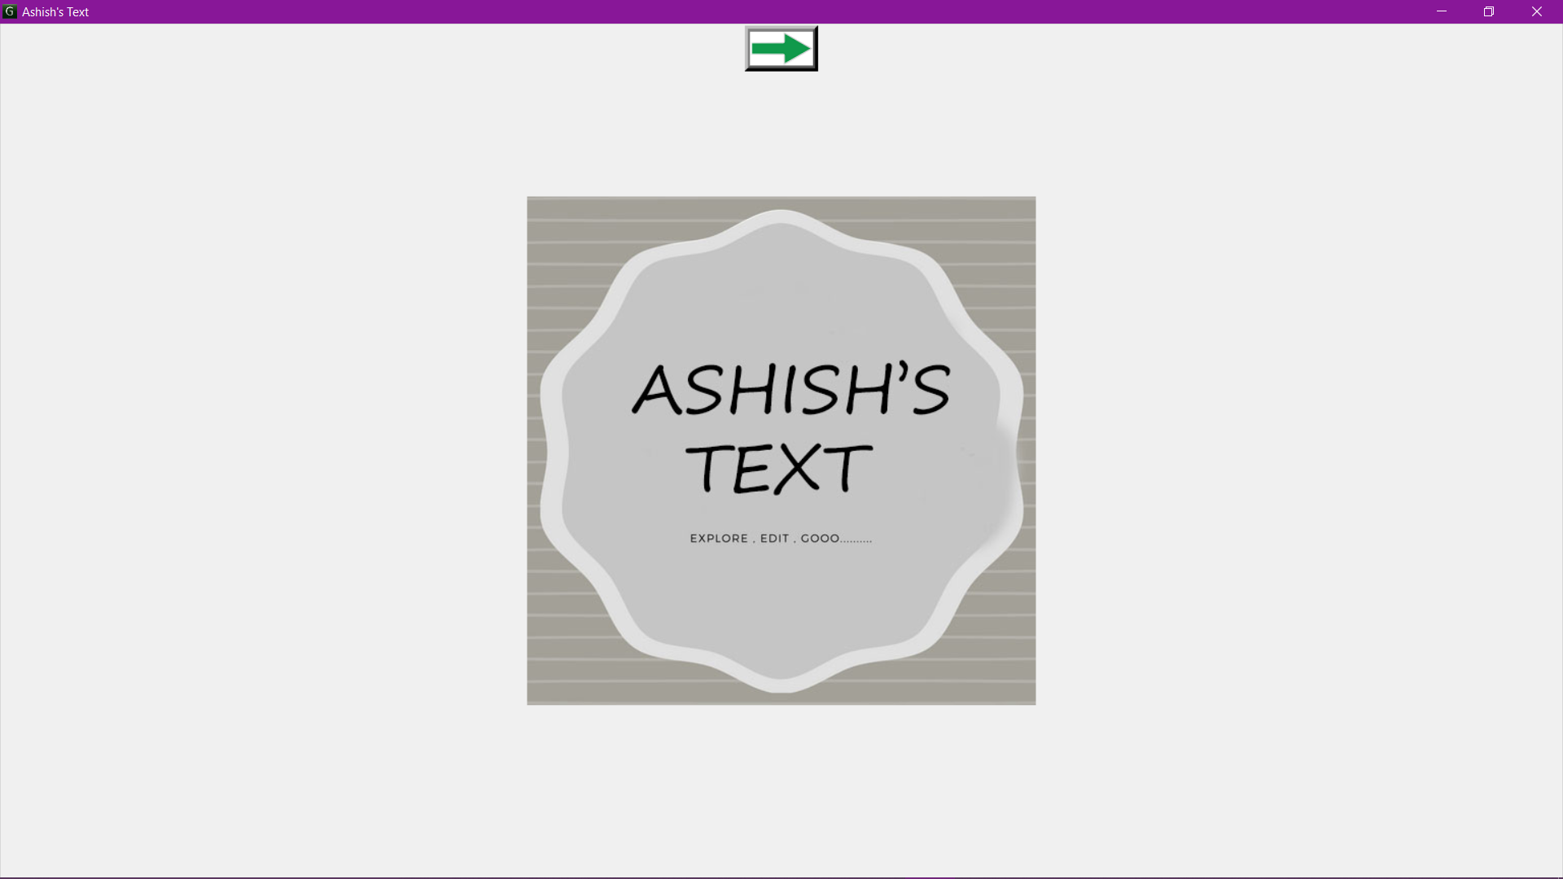
First Page

Slide 11
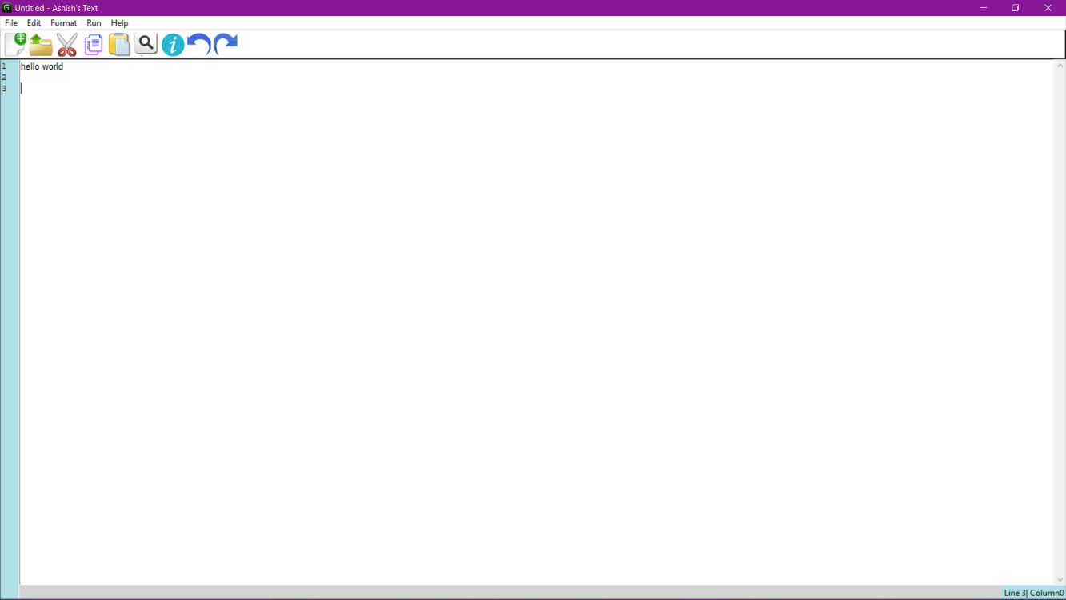
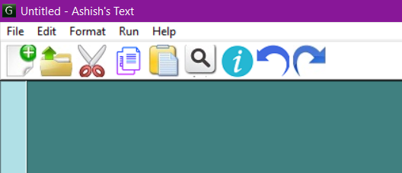

Main window
It includes all the above mentioned modules like icons for cut copy paste save or opening a new file.
Logo

Slide 12
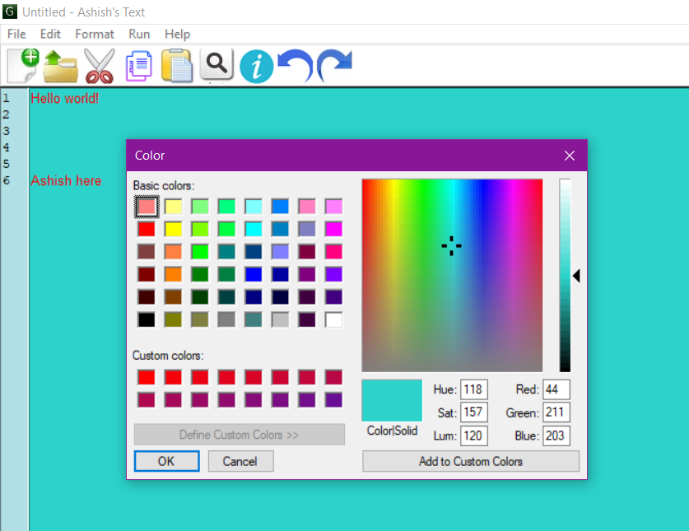
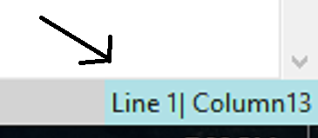
Various Functionality
Font color and background color
Line and column number

Slide 13
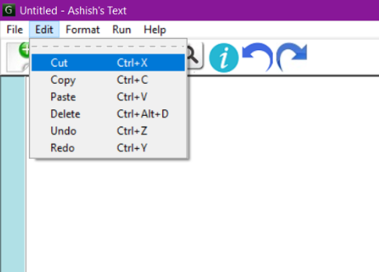
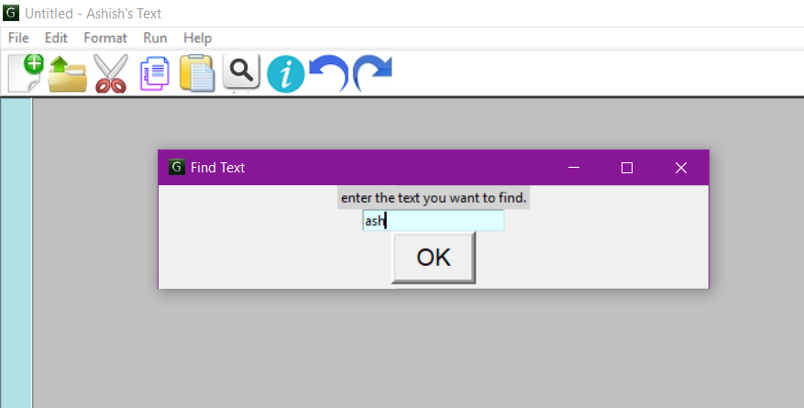
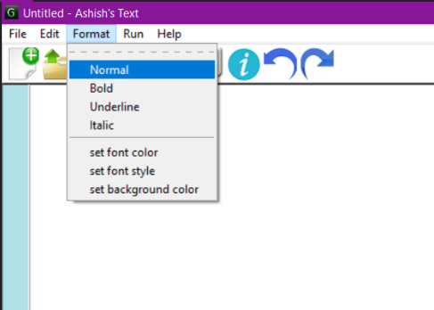
Various Functionality
Find text
Menu

Slide 14
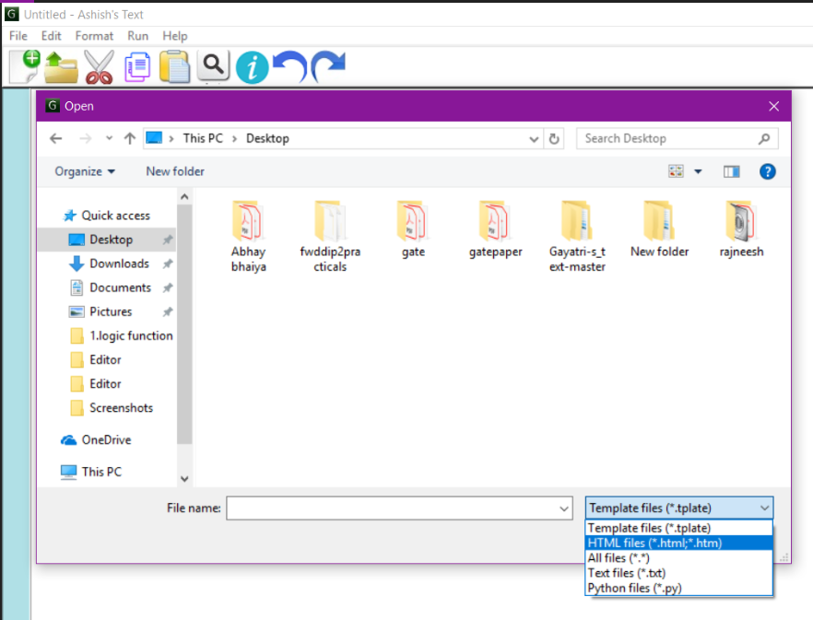
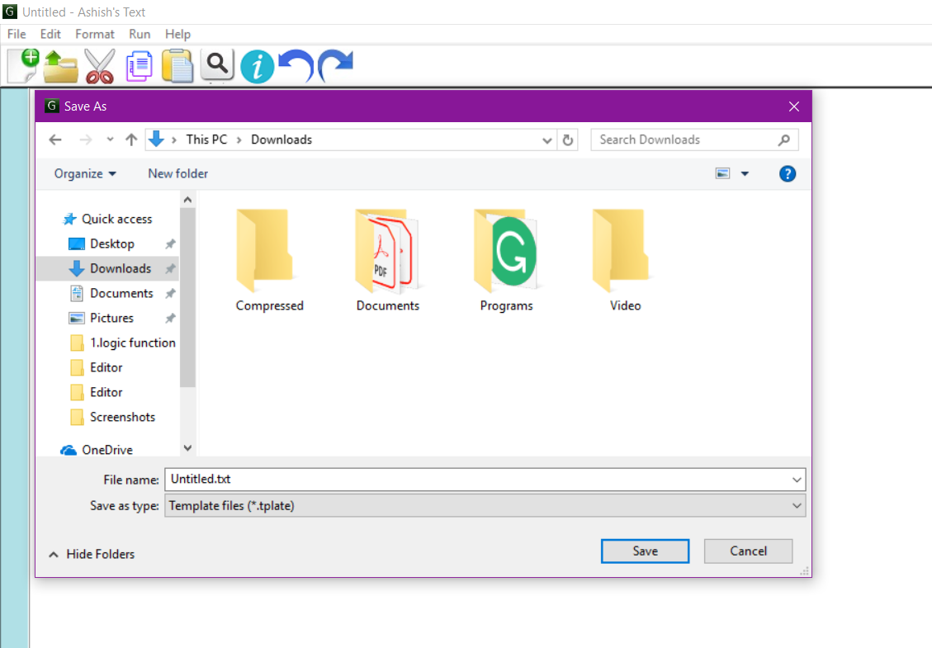
Various Functionality
Open Menu
Save Menu

Slide 15
Some Features of ASHISH’S TEXT
Create A New Text Document.
Open A Text Document File.
Edit A Text Document file.
View All Text Document.
Find and replace.
Cut, copy, and paste.
Text formatting.
Undo and redo and many more.
Font coloring
Background coloring
Line numbering column numbering
Including shortcuts for various icons with their symbols.

Slide 16
Conclusion and Future Scope
My project (ASHISH’S TEXT): In this project we can create a new text document by editing.IN this project we can also create a new text document . in this project we can also view a already presence text document . Plain text exclusively consists of character representation. Each character is represented by a fixed-length sequence of one, two, or four bytes, or as a variable-length sequence of one to four bytes, in accordance to specific character encoding conventions.
We can extend its functionalities by adding more features into it like:
we can implement idea like if user write wrong word then it auto corrects
we can Check info about the latest version update of Text editor.
We can add keywords for whatever extension the user is working on.
Language selection
Browser running and running with CMD

